Slide 1
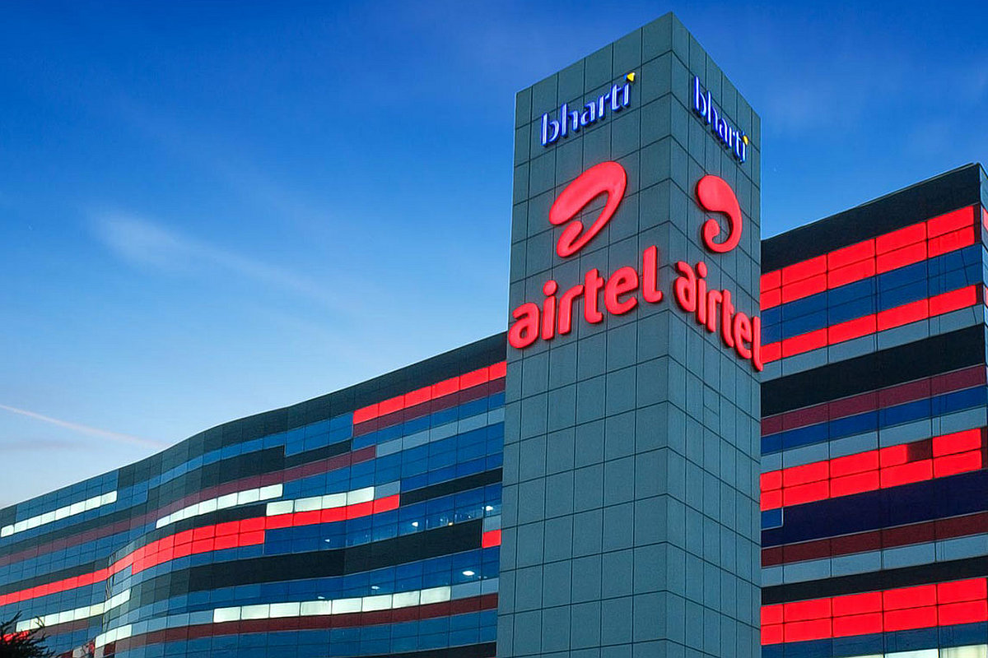
Scope Of M&A Pitch Presentation of BHARTI AIRTEL
Prepared by : - Priyanka Rohra
Kamesh Gurao
Samiksha Revadkar
Pooja Mehto
Sri Bharath Vasa

Slide 2
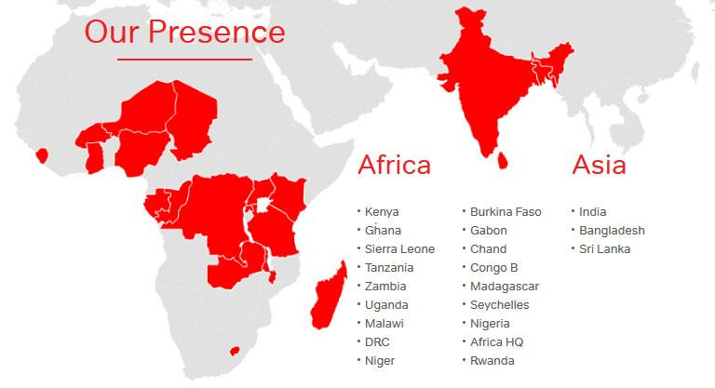
Bharti Airtel Ltd | Company Overview
∙ Bharti Airtel Limited also known as “Airtel”, It is an Indian global
telecommunications services company headquartered at New
Delhi, India and operating in 18 countries
∙ It operates a GSM network in all countries, 3G, 4G LTE, 4G+
mobile services, fixed line broadband and voice services
depending upon the country of operation
∙ Airtel had also rolled out its VoLTE technology across all Indian
telecom circles. It is the second largest mobile network operator
India and second largest mobile network operator in the world
with over 439.84 million subscribers
∙ Bharti Airtel was named India's 2nd most valuable brand in the
first ever Brandz ranking by Millward Brown and WPP plc.
∙ Bharti Group was established in 1983 by Sunil Mittal
∙ In 1984 Bharti Telecom limited was incorporated,
first company to offer Push button phones name as
‘Mitbrau’.
∙ In early 90’s country’s first Fax machines and cordless
phones were launched by BTL
∙ In 1992, Sunil Mittal to set up a cellular network in
Delhi
∙ Bharti Airtel Limited is a leading global
telecommunication company with operations in 21
countries across Asia and Africa.

Slide 3

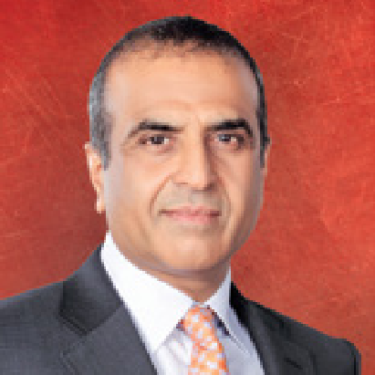
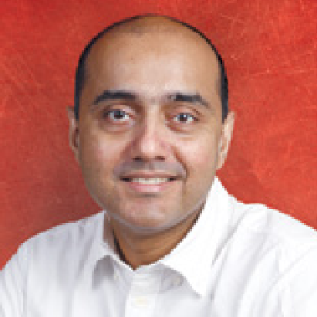
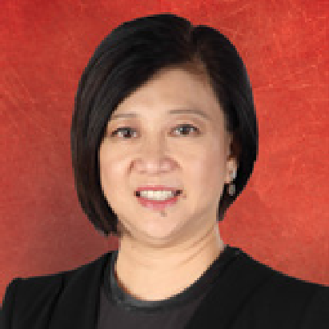

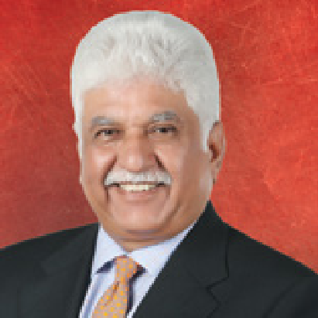
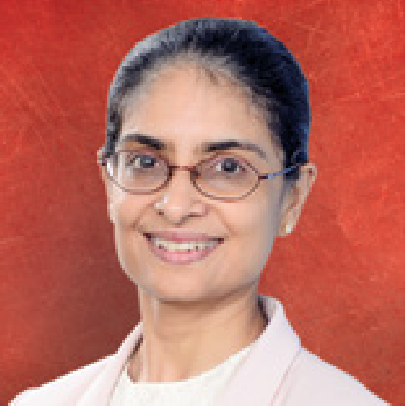
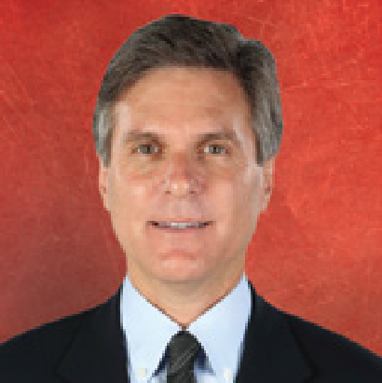
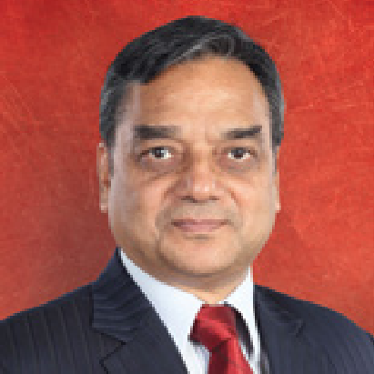
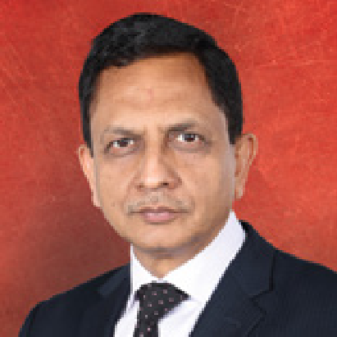
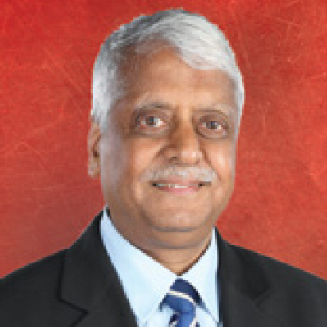
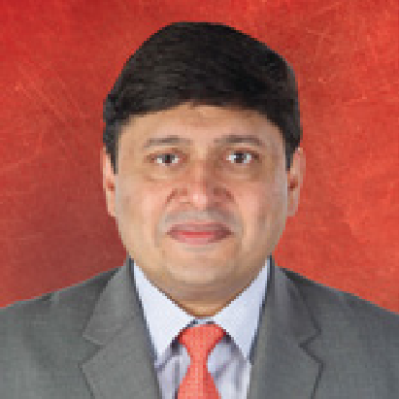
Bharti Airtel limited - Organization structure (India and South Asia)
The board of directors of the company has an optimum
mix of executive and non-executive directors, which
consists of two executive and nine non-executive
directors. Mr. Sunil Bharti Mittal, Chairman and Mr.
Gopal Vittal, MD & CEO (India and South Asia) are
two executive directors on the board is 50% of the total
board strength
∙ The board members possess requisite skills, experience
and expertise required to take decisions, which are in the
best interest of the company.
Mr. Sunil Bharti Mittal
CHAIRMAN
Gopal Vittal
MD & CEO
(INDIA & SOUTH ASIA)
Ms. Chua Sock Koong
Non-Executive Director
Ms. Tan Yong Choo
Non-Executive Director
Mr. Rakesh Bharti Mittal
Non-Executive Director
Ms.Kimsuka Narasimhan
Independent Director
Mr. Craig Edward Ehrich
Independent Director
Mr.Dinesh Kumar Mittal
Independent Director
Mr. Shishir Priyadarshi
Independent Director
Mr. V.K. Viswanathan
Independent Director
Mr. Manish Kejriwal
Independent Director

Slide 4

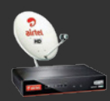
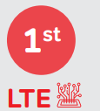
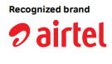
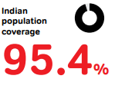
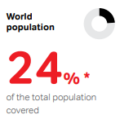
Key Highlights Over The Years
Introduced first India’s mobile banking platform.
Launched OTT mobile network application with Wynk Music.
Partner with Apple to introduce ‘ IPhone 3G’.
Became first mobile operator to introduce Voice over Wi-Fi in India. Became first mobile operator to introduce Voice over Wi-Fi in India.
First to deploy LTE advanced 4G technology.
Pioneered mobile music with the launch of ‘ Hello Tunes’.
Launched high speed 4G services commercially in 334 towns across India.
Announced the launch of first indigenously manufactured DTH set top boxes; in step with the Government’s ‘Make in India’ initiative.
Deployed LTE 900 technology in 10 Circles to offer significantly better indoor 4G coverage.
In addition to the above, Airtel own and operate more than 42,053 telecom towers with presence across all 22 telecom circles.
Airtel also owns India’s first payment bank across all 28 states in India.
Wireless Services
Postpaid
Home Services
Fixed Line Telephone
Digital TV Services
DTH platform
Airtel Business
Provider of ICT services to enterprises , government and small & medium enterprises
Broadband including high speed broadband on copper and fiber
Voice connectivity
Both Standard and HD TV services with Dolby surround sound
Network Integration , data centres ad digital media
Prepaid
Data Connectivity
International Roaming
Business Divisions

Slide 5
Revenue Model
Mobile Business
Prepaid and Postpaid
Digital Services
More than 645 Channels
Highest ARPU (Rs. 157) in the industry, most of it comes from Smartphone user.
Only 5% of revenue comes from Postpaid , rest comes from prepaid
Still provide 2 G for feature mobile.
Churn rate is 1 %
Revenue has increased with ARPU at Rs. 149
Customer has increased too
Data Subscriber
Churn rate 2.2%
Airtel Business
14% of Revenue
Consistently increasing subscribers over the years
25% revenue comes from Africa
Competition from JIO led to loss in business from Bangladesh
Cloud Network , Partnered with GOOGLE and AWS
Revenue has grown significantly .
Help global 2000 companies with voice , data , network and Cloud.
Home Services
Broadband
Infrastructure
8% of Revenue – Bharti Infratel
7% revenue comes from broadband business
Churning rate is very low
ARPU Rs. 1000 to Rs 800
Customer are deemed to be more loyal than mobile data subscriber
They have more than 95000 towers.
They provide these infrastructure to other Telecom as well.
It has witnessed stable growth.

Slide 6
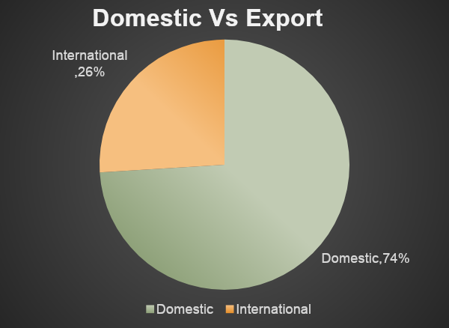
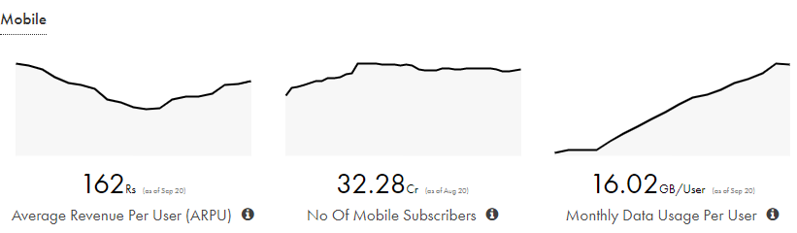

New structure to drive the next phase of company’s growth
» Creation of B2C and B2B business verticals for enhanced business
efficiency and employee value
» Transformation from a ‘technology’ facing organisation structure to a
‘Customer’ facing one
» Will provide enhanced empowerment to employees

Slide 7
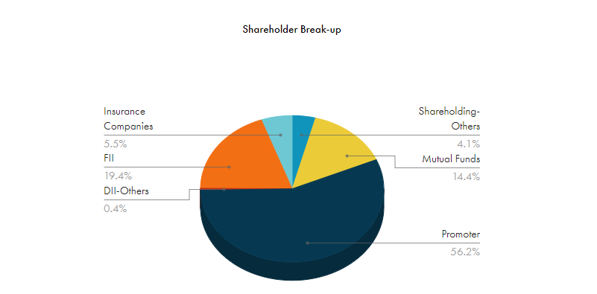
Shareholder Holding Overview
Promoter’s Shares have been reduced from 68% to 56%
Company has tried to raise money in the past.
There are no pledged shares.

Slide 8
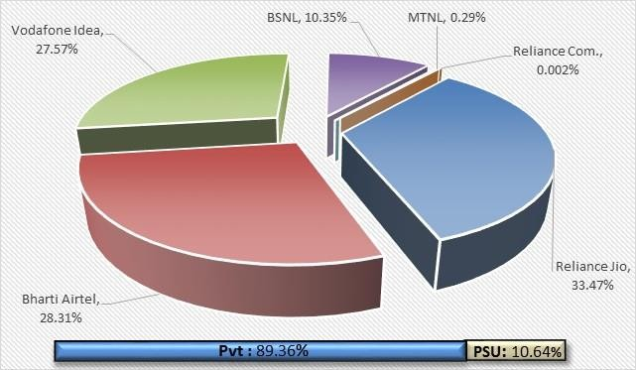
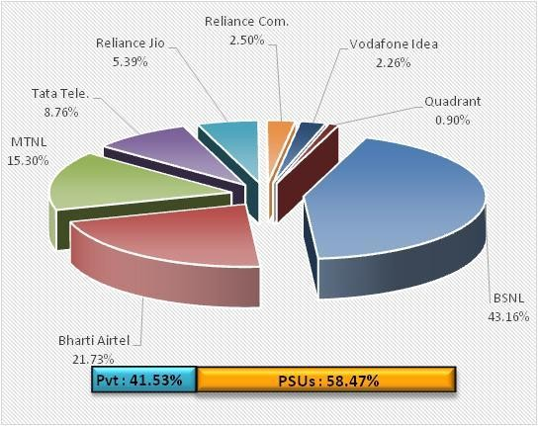
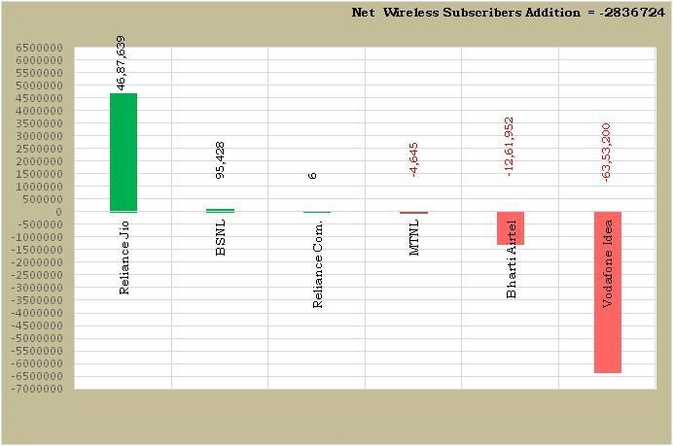
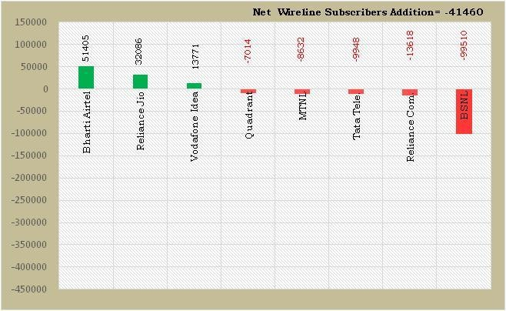
Access Service Provider-wise Market Shares in term of Wireless Subscribers as on 31st March, 2020
Access Service Provider-wise Market Shares of Wireline Subscribers as on 31st March, 2020
Net Additions in Wireless Subscribers of Access Service Providers in the month of March, 2020
Access Service Provider-wise Net Additions/declines in Wireline Subscribers during the month of March, 2020
Note: 1. M/s Bharti Airtel Ltd has reported the wireless subscribers including the subscribers of M/s Tata Teleservices Ltd.

Slide 9
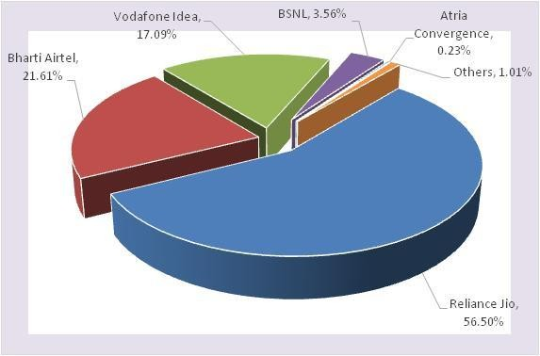
Service Provider-wise Market Share of Broadband (wired + wireless) Services as on 31.03.2020
As on 31st March, 2020, the top five Wired Broadband Service providers were BSNL (8.08 million), Bharti Airtel (2.47 million), Atria Convergence Technologies (1.61 million), Hathway Cable & Datacom (0.97 million) and Reliance Jio Infocomm Ltd (0.87 million).
As on 31st March, 2020, the top five Wireless Broadband Service providers were Reliance Jio Infocom Ltd (387.52 million), Bharti Airtel (146.10 million), Vodafone Idea (117.43 million), BSNL (16.43 million) and MTNL (0.18 million).

Slide 10
Competitor Analysis
Best OP Margins & Net Profit Margins among Peers
Company | Op Margin (%) |  | Net Margin (%)
 | Mar-20 | Mar-19 | Mar-20 | Mar-19
Bharti Airtel | 12.25% | 6.93% | -35.77% | 1.64%
JIO | 13.40% | 12.58% | 6.66% | 6.98%
Vodafone Idea | -18.69% | -26.31% | -165.11% | -39.90%
MTNL | -107.86% | -80.72% | -227.52% | -162.43%

Slide 11
OPERATOR WISE MARKET SHARE TELCOM COMPANIES (MARCH 2020)
Operators | Subscribers in Millions | Market Share (Mar’20)
JIO | 387.5 | 33.60%
Airtel | 327.8 | 28.40%
Vodafone-Idea | 319.1 | 27.60%
BSNL | 119.7 | 10.40%
Total | 1154.1 | 100.00%
Bharti Airtel, owned by Mr. Sunil Bharti Mittal is the second largest telecom company in India with a 28.4% market share and 327 Million subscribers.

Slide 12
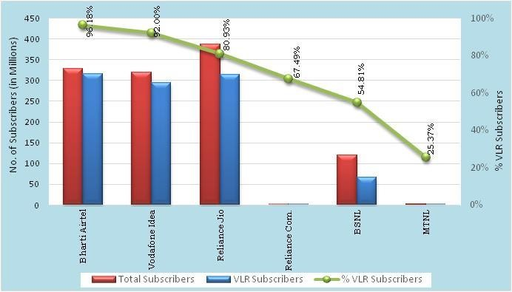
Threat from Competition - Visitor Location Register
Bharti Airtel has the maximum proportion (96.18%) of its active wireless subscribers (VLR) as against its total wireless subscribers (HLR) on the date of peak VLR in the month of Mar-20

Slide 13
Operating Highlights | 2019 | 2018 | 2017 | 2016 | 2015
Mobile Services | 3,84,078 | 3,95,722 | 3,55,673 | 3,42,040 | 3,10,884
Homes Services* | 2,270 | 2,172 | 2,129 | 1,949 | 1,679
Digital TV Services | 15,392 | 14,168 | 12,815 | 11,725 | 10,073
Airtel Business* | 1,904 | 1,760 | 1,736 | 1,714 | 1,732

Slide 15
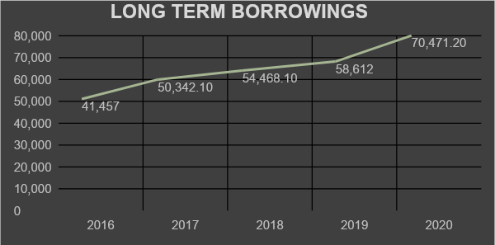
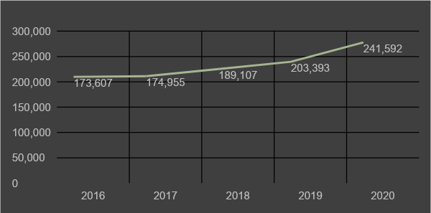
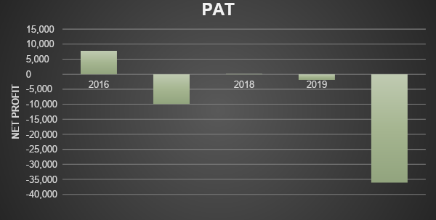
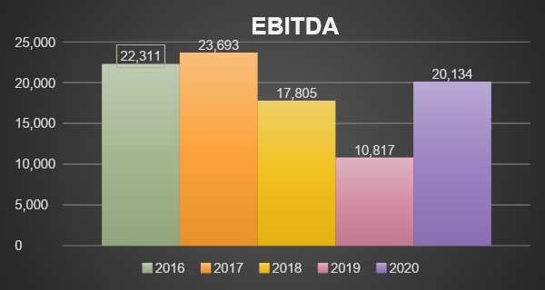
LONG TERM BORROWINGS
ASSETS
NET PROFIT/PAT
OPERATING PROFIT/ EBITDA
CASH FLOW POSITION IN LAST 5 YEARS
PARTICULARS | MAR 2016 | MAR 2017 | MAR 2018 | MAR 2019 | MAR 2020
Profit Before Tax | 10,254.20 | -8,509.50 | -681.20 | -5,243.90 | -51,020.90
Working Capital Changes | 53.80 | -81.60 | -2,679.30 | -3,477.90 | -16,403.80
Tax Paid | -2,179.70 | -1,443.90 | -240.40 | 948.20 | -309.20
Operating Cash Flow | 19,449.90 | 21,165.50 | 15,954.30 | 10,812.10 | 4,026.40
Investing Cash Flow | -21,989.30 | -24,283.20 | -17,210.80 | -20,455.90 | -22,271.50
Financing Cash Flow | 1,898.40 | 3,455.70 | 1,636.90 | 9,397.60 | 21,114.10
Net Cash Flow | -641 | 338 | 380.40 | -246.20 | 2,869

Slide 16
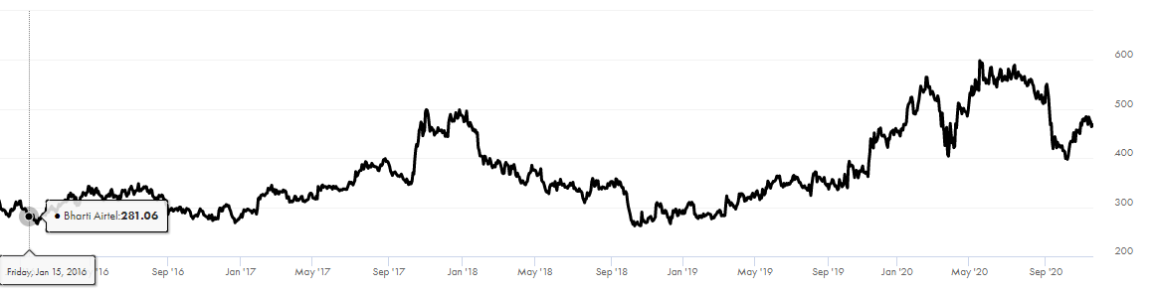
Market Share Price of Bharti Airtel Over 5 Years
KEY FINANCIAL RATIOS
 | Mar'15 | Mar'16 | Mar'17 | Mar'18 | Mar'19 | Mar'20
ROE % | 14.93 | 8.69 | 1.69 | 0.43 | -3.85 | -7.33
Operating Profit Margin % | 35.19 | 37 | 38.04 | 33.18 | 21.81 | 37.07
Net Profit Margin % | 19.5 | 13.69 | 2.89 | 0.82 | -7.81 | -13.48
Debt to Equity | 0.28 | 0.41 | 0.6 | 0.64 | 0.85 | 0.81
Working Capital Days | 221 | 155 | 119 | 171 | 248 | 381
Cash Conversion Cycle | -50 | -59 | -85 | -105 | -107 | -108

Slide 17
Airtel – Then and Now……
1996 |  | 2019
Single Circle Operator | Company Profile | Largest integrated private telecom operator
< 25k | Customers | ~ 403 mn
~ USD 17 mn | Revenue | ~ USD 808 bn
~ USD 2.5 mn | EBITDA | ~ USD 2 bn
~ USD 1.4 mn | Cash Profit | ~ USD 168 bn
~ USD 16 mn | Market Capitalization | ~ USD 450 bn
Continuing on our journey of value creation

Slide 18
Mergers and Acquisitions
MTN Group
Airtel twice attempted to acquire 100% of MTN for 45 billion$ but the talks failed and couldn’t reach a solution as India doesn’t allow dual listing.
Zain Operations Airtel acquired Zain operations which has operations in 15 countries in Africa for $10.7 billion from a Kuwait firm in June 2010 making Airtel fifth largest wireless
provider.
Warid Bangladesh and Robi sold a majority of 70.9Warid telecom 0% to Airtel on January 2010 upon acceptance by Bangladesh telecommunication commission and remaining to Singapore
based Airtel concern. Airtel Bangladesh merged with Robi a brand product of Robi, Robi axiata was licensee name with axiata holding 68.7% and Airtel holding
25%.
Telecom Seychelles
Airtel acquired 100% of telecom Seychelles for 62 million$ and making it present in 19 countries. Airtel has 57% of market share. It is also participating in
Seychelles east Africa submarine cable aiming to build 2000 km underwater high speed link to Tanzania.
• Augere Telecom Airtel purchased Augere wireless broadband a company provides 4G spectrum to Madhya Pradesh and Chhattisgarh circles in a deal worth 21 million$.
Telenor India Airtel acquired Telenor assets and customers from seven circles of Telenor and acquired 43.4Mhz frequency band by paying 1600cr INR over 10 years.
Tikona Spectrum
March 2017, Airtel acquired 350 cellular cites and 5 circles of Tikona spectrum and deal included 20Mhz 4g spectrum.
Millicom International Cellular SA December 2017 signed a agreement with Millicom to acquire 100% stake in Rwanda operations under the name Tigo Rwanda.
Tata Teleservices and Tata Docomo Airtel announced it will acquire Tata teleservice limited, Tata Docomo and Tata Teleservices Maharashtra limited. By July 2019 it finished acquired all the three
services from Tata and absorb 19 circle of operations and will get three additional band of spectrums which are widely used for 4G.

Slide 19
POTENTIAL BUYER
Reliance Jio
For now reliance jio has twice as valued as Airtel that is down 25% from its peak on May. Now, the market value of reliance jio at 4.9 crore, is nearly twice the size of Airtel, whose market capitalisation is down to 2.4 crore lakh.
The latest blow came from competitor Jio's new post-paid plans that offer a slew of added benefits.
Investor fear that competitive pressure on one hand from Jio and Vodafone Idea surviving on the other may hurt Airtel.
Investors in Bharti Airtel had bet the Vodafone-Airtel may not survive long for too long, and the presure of competitive tariffs from Reliance Jio is now in the past. Both bets are seems to be undone and shares of Airtel, India’s second largest telecom service provider, have lost 25% of there value since the peak the stock hit in may 2020.
lets see what we see further.
Adani Group
As per report by Moneycontrol website Adani group could be the second biggest company that could be potential buyer
of Bharti Airtel.
Adani Enterprises hit a fresh 52-week high of Rs 364.60, Bharti Airtel rallied nearly 5 percent on Monday.
As per companies financial highlights, Consolidated income from operations increased by 12% to RS 40,379 Crores VS RS 35,924 Crores in FY 18.
Consolidated EBIDTA stood at RS 2,541 Crores VS RS 2,626 Crores in FY 18.
As per Standalone Financial result:- On standalone basis, total income of RS 15,923.60 Crore and PAT of RS 487.24 Crore, the operational performance of company has been comprehensively increased and seems like have a big hand on telecom sector too in upcoming days.

Slide 20


